Slide 1
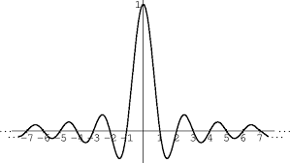
Raz Rajwan || Gal Oren
Speaker and Speech Recognition from raw waveform with SincNet

Slide 2
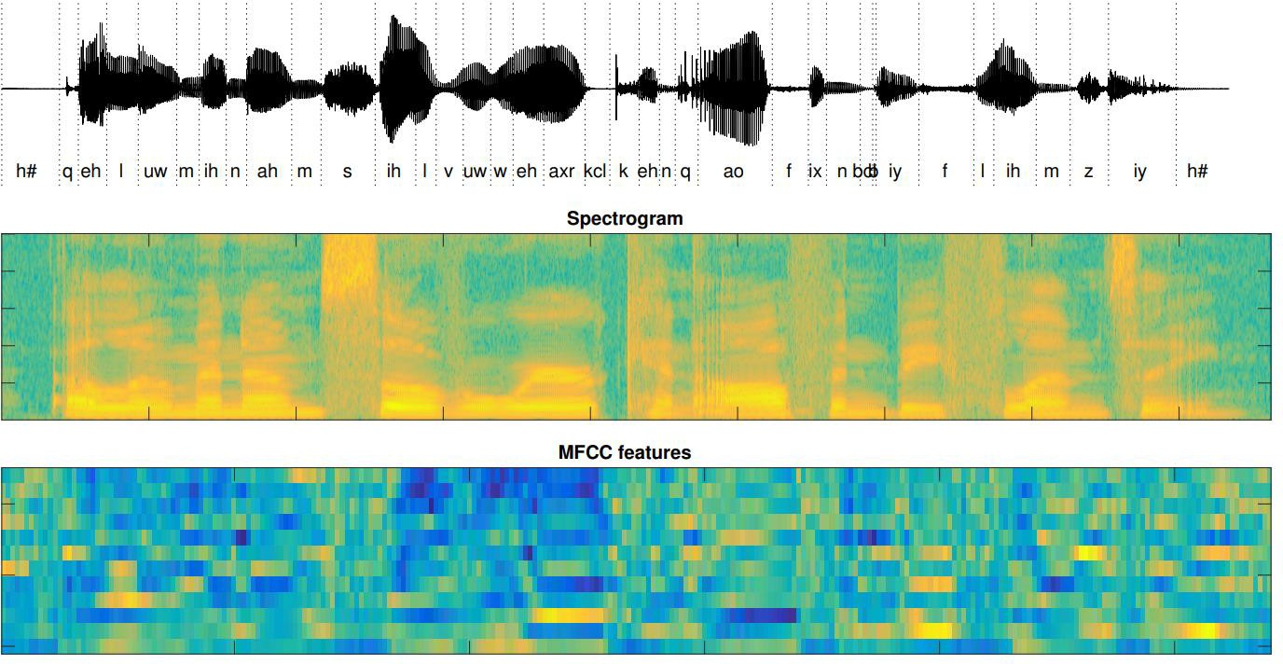
Proccesing audio wave forms
Audio sequences are very high dimensional, feature extraction is needed:
Raw Wave Form
MFCC-mel-frequency cepstrum
Spectogram
Complex feature extraction:
d-vectors
x-vectors

Slide 3



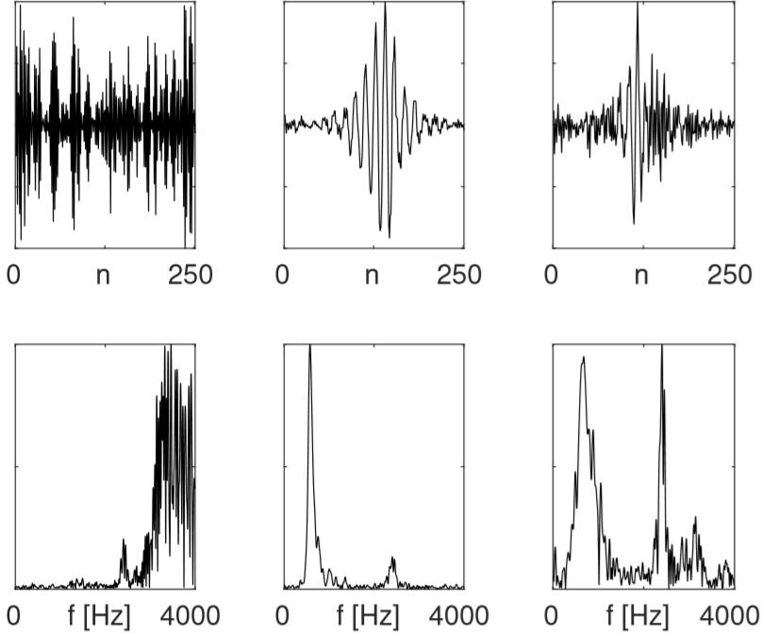



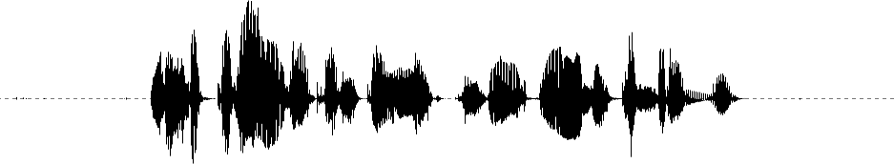
Standart Approach
The standard DL approach is to feed the audio samples in to a CNN and classify
Cons of this method:
Highly dimension input
Vanishing gradients
The learned filters resemble band pass filters
in the frequency domain (with distortions)
Classification
Softmax
CNN/DNN layers Dropout
Leaky ReLU Layer Norm
Pooling
Convolution
Speech Waveform

Slide 4





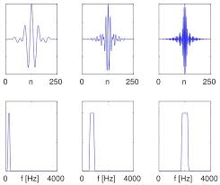







SincNet
Speaker
Classification
Instead of learning CNN coefficients, SincNet
Learns only the cutoff frequencies
Pros:
Fewer parameters
Fast Convergence
Interpretable model
Softmax
CNN/DNN layers
Dropout
Leaky ReLU
Layer Norm
Pooling
Speech Waveform

Slide 5
The Data Set

Slide 6
Our Solution

Slide 7
Our Architecture

Slide 8
Experiments Work

Slide 9
Results

Slide 10
Summary

Slide 11

Questions?

